Slide 1
CIS 285 Term Project
Department of Computer Information Science
CIS 285 Software Engineering Tools Winter 2019
Marco Seman
Professor Zhiwei Xu
April 9, 2019

Slide 2
E-Guard Software
‘E-Guard’ Allows parents to check web activity, keystrokes, chat, email, Instant Messenger, and Launched Application.
The ‘E-Guard’ software is standalone that can be run using Microsoft Windows, Linux, or Mac X, iOS Operating Systems.

Slide 3
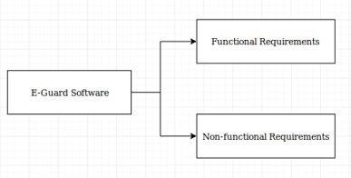
Types of Requirements:

Slide 4

Functional Requirements
E-Guard will allows parents to monitor their children's web activity, keystroke, chat, email, Instant Messenger, and launched application
The launched applications will be associated with the device E-Guard is installed on.
E-Guard will maintain a local database of safe and hazardous websites along with updating the database with the remote server daily. The remote server will be maintained by a 3rd party vendor who'll add and update hazardous websites.
The 3rd Party vendor will create and maintain the remote server. Our goal will be to copy the database to the local drive on a daily basis.
E-Guard will block inappropriate and dangerous websites.
E-Guard will delete inappropriate terms from the search engine.
The 3rd party vendor will create and maintain the list of common dangerous and inappropriate terms.
When there is a suspicious activity like browsing an inappropriate or dangerous website, the E-guard system will take a screenshot.
Parents will be allowed to configure the E-Guard software to their choosing. The configurable settings will include settings such as blacklist and whitelisting websites.
The configuration settings can control keywords, internet usage time, and categories to be blocked which will be created and maintained by the 3rd party vendor.
Security measures include configuration and uninstall actions be restricted to authorized users only.

Slide 5
Non-Functional Requirements
Usability:The E-Guard will allow parents the option to change color interface to either light or dark mode.
1
Serviceability: The E-Guard will offer a 24/7 technical support for any operational and functional issues.
2
Maintainability: E-Guard will have a warranty for technical support for at least one year.
3
Capacity: The 3rd party vendor will keep a long list of bad websites stored in their database
4

Slide 6
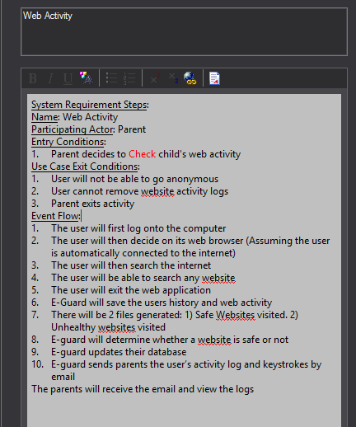
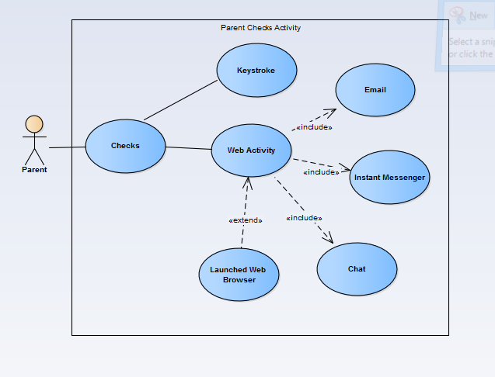
Use Case Diagram: Parent Checks Activity
Notes:
The use case model is a catalog of all the systems functionality. Each use case will represent the interaction between the user(parent or child) and the system.

Slide 7
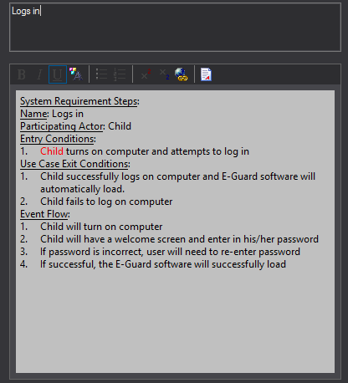
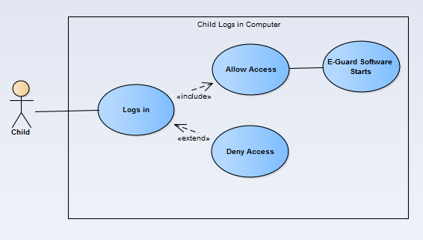
Use Case Diagram: Child Logs in Computer

Slide 8
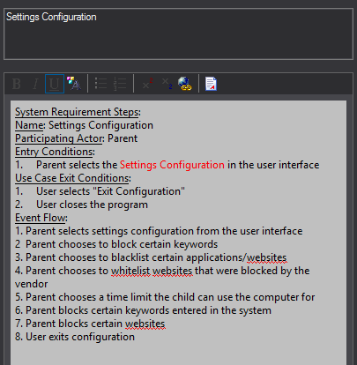
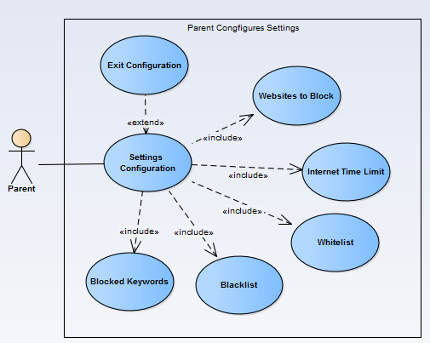
Use Case Diagram: Parent Configures Settings

Slide 9
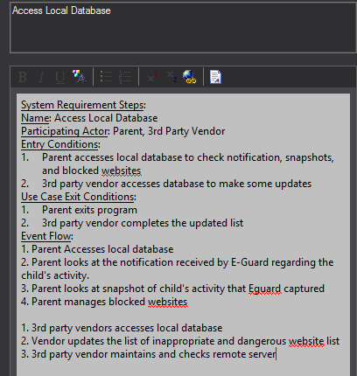
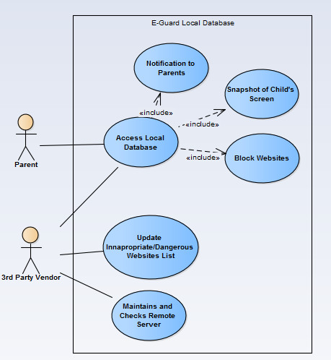
Use Case Diagram: E-Guard Local Database

Slide 10
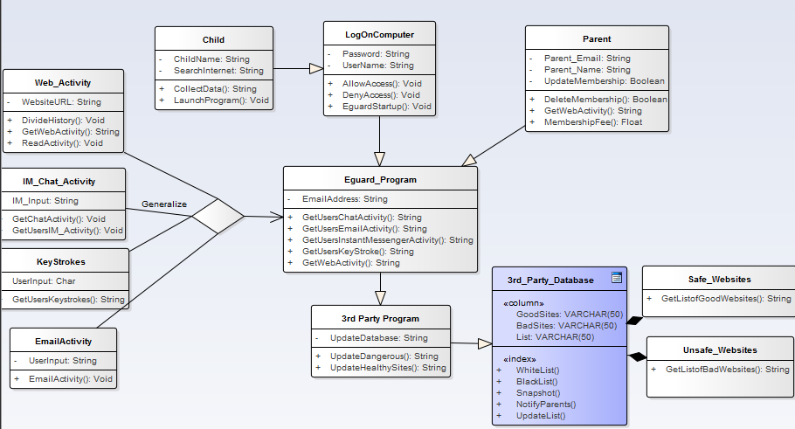
Class Diagram
Notes:
Class diagram is the logical structure of the system and classes that make up the model.

Slide 11
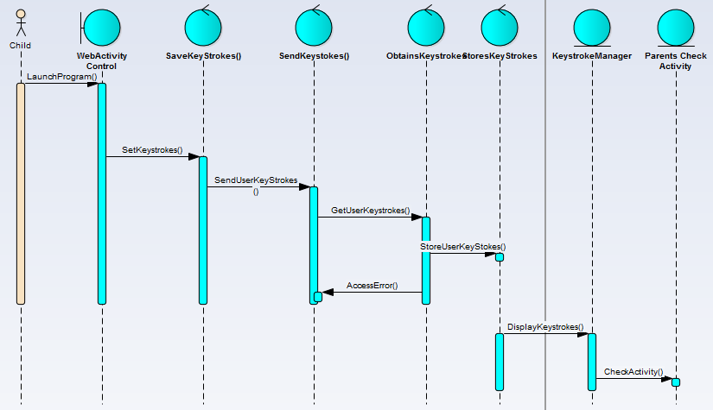
Sequence Diagram: Child Web Activity
Notes:
Sequence Diagram Broke. Have no idea how to fix it on enterprise architect...

Slide 12
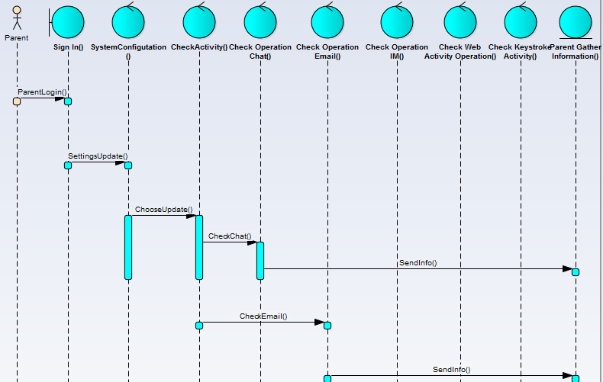
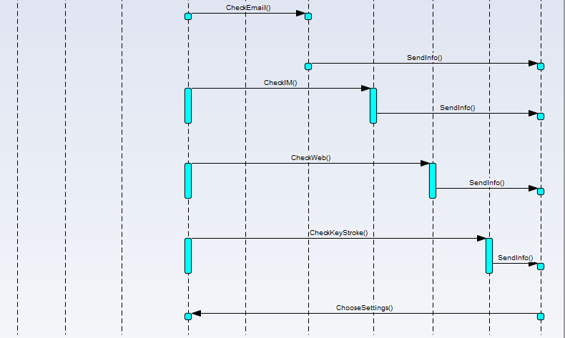
Notes:
Parent Signs in E-Guard

Slide 13
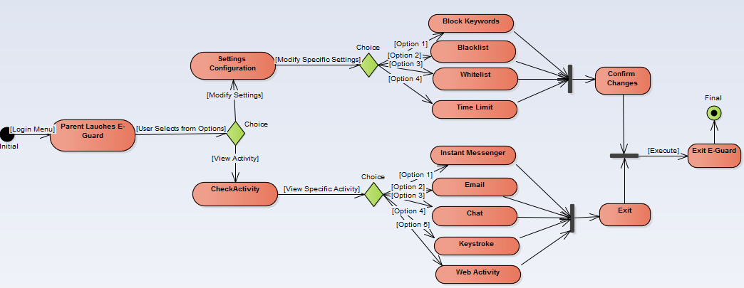
State Diagram

Slide 14
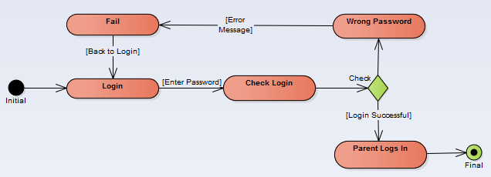
State Diagram

Slide 15
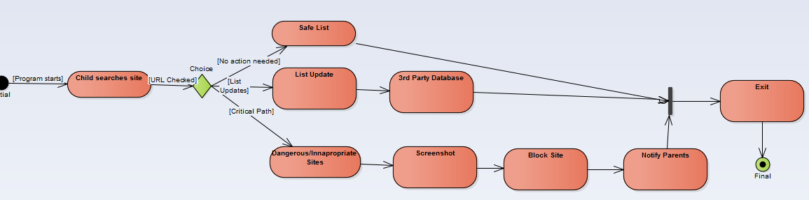
State Diagram

Slide 16
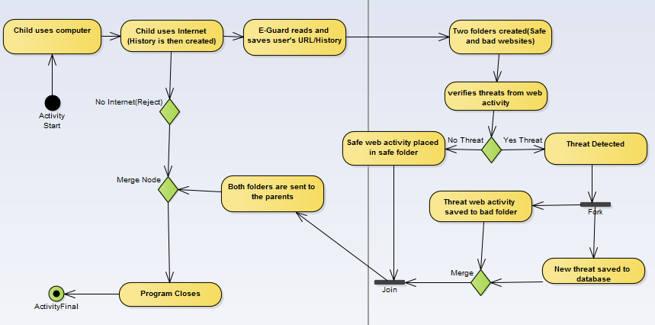
Activity Diagram

Slide 17
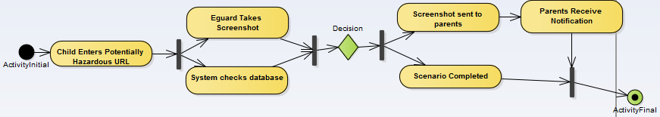
Activity Diagram

Slide 18
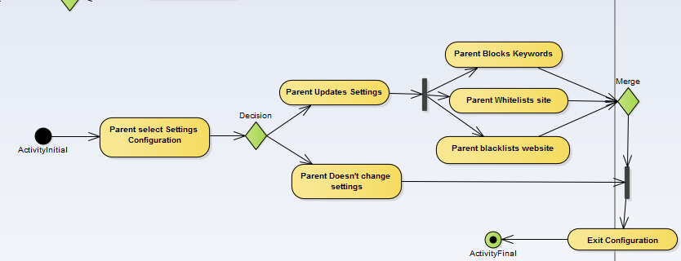
Activity Diagram

Slide 19
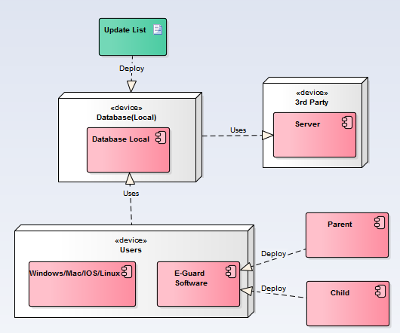
Deployment Diagram

Slide 20
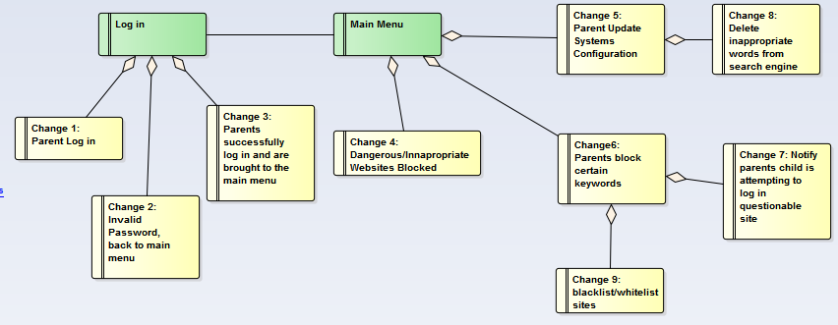
Functional Requirement Diagram

Slide 21
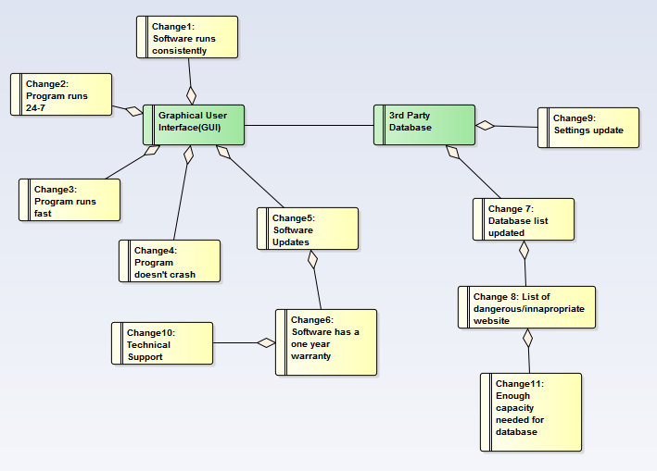
Non-Functional Requirement Diagram

Slide 22

Thank You

